Slide 1

RAKSHAK
A VIOLENCE DETECTION SYSTEM

Slide 2
India is the fourth-worst country in the world for religious violence
Many thousands killed each year in violent conflicts, there are huge numbers who are injured as a result
many thousands killed each year in violent conflicts, there are huge numbers who are injured as a result
Crimes in India rise in 2019 as compared to last year; murder, rapes see a spike

Slide 3

HOW DO WE HELP? RAKSHAK detects violent activities via CCTV cameras, sends an alert to the assigned incharge to check the CCTV live footage, if the situation needs police interference, the incharge can press a button on our application, and police/ ambulance will be able to view the route to the location , to go and handle the crime scene.

Slide 4
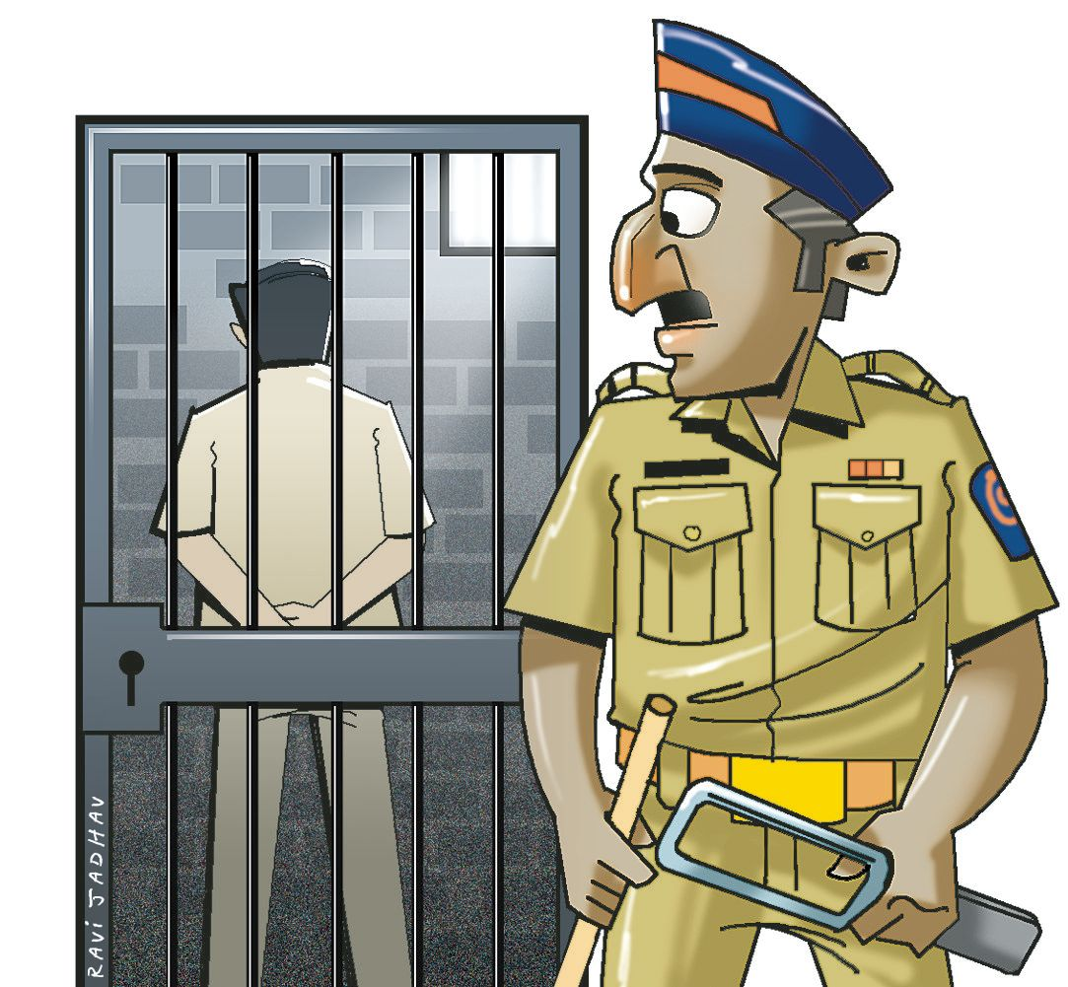
TARGET AUDIENCE
Our target audience is scalable to 2 segments
1) Public Infrastructure Sector
Indian Govt. has allocated a fund of 2000 Cr. for creating a comprehensive and integrated system for effective policing through E-Governance.
Rakshak can be used by police to monitor Public Fights nation wide.
2) Commercial Sector
According to a recent research, a big percentage of crimes takes place in big basements.
Rakshak can be used by big scale companies, Residential Localities, Malls, etc. for monitoring the CCTV cameras of their basement.

Slide 5

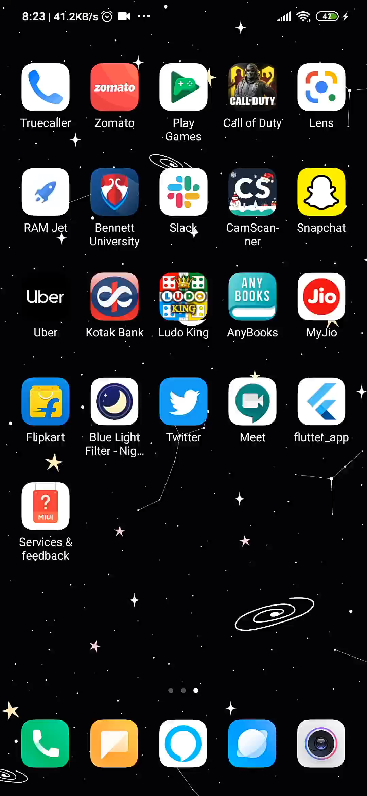
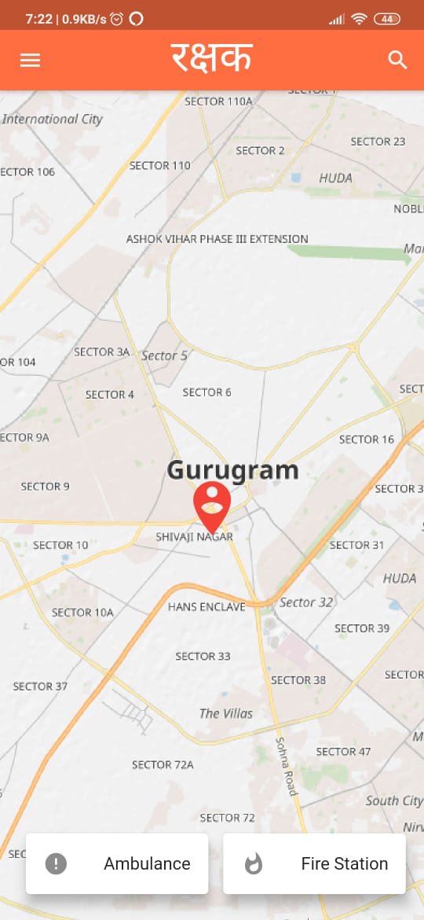
OUR USER INTERFACE

Slide 6
THANK YOU
REGARDS-
TEAM WILDCARD
TEAM NUMBER 15

